Slide 1
DS 6371: Lecture 1
DRAWING STATISTICAL CONCLUSIONS
RANDOMIZED EXPERIMENTS V. OBSERVATIONAL STUDIES
RANDOM SAMPLES V. SELF-SELECTION

Slide 2
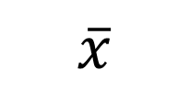


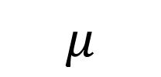
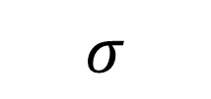

Symbols!
Standard Deviation
Mean
Variance
Sample
Population

Slide 3
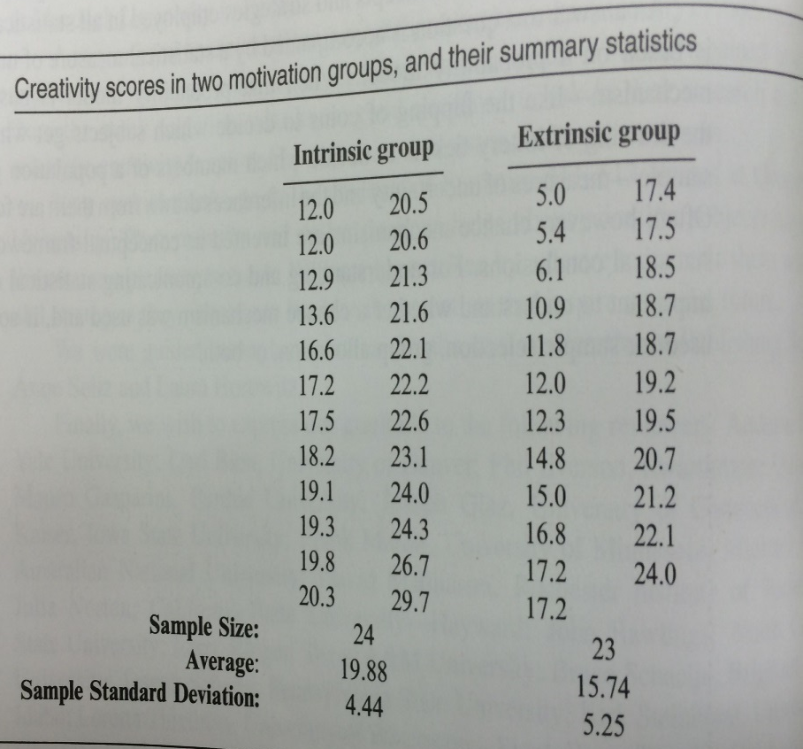
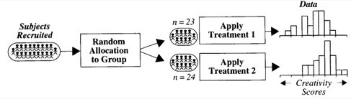
Creativity Scores:
Intrinsic vs. Extrinsic Motivation
Subjects volunteered for the study.
Then, treatments were randomly assigned.
Notes:
This is an example of what the book calls “Statistical Conclusion”.

Slide 4
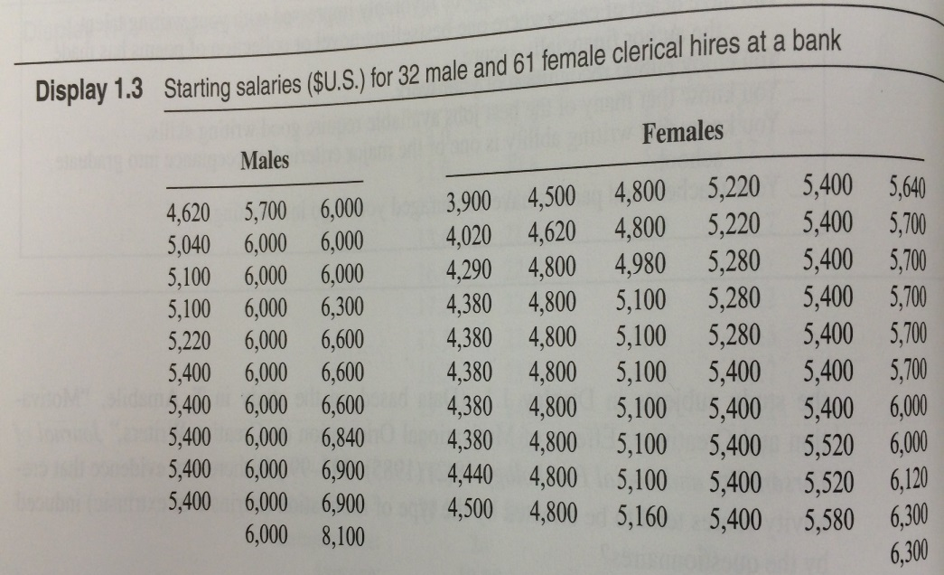
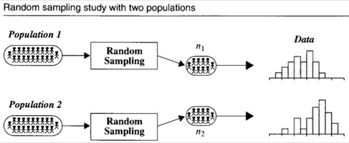
Starting Salaries:
Female vs. Male
Subjects were NOT randomly chosen by the researcher (all employees at a bank were included), and the group assignments were not random either.
If a random sample of the employees had been used…

Slide 5
Types of Studies
Creativity Study
Salary Study
Randomized Experiment
Observational Study

Slide 6
Causal Inference:
Randomized vs. Observational Study
Causal inferences can be drawn from randomized experiments
Causal inferences cannot be drawn from observational studies due to possibility of CONFOUNDING
CONFOUNDING VARIABLE: Related to both group membership and to the outcome

Slide 7
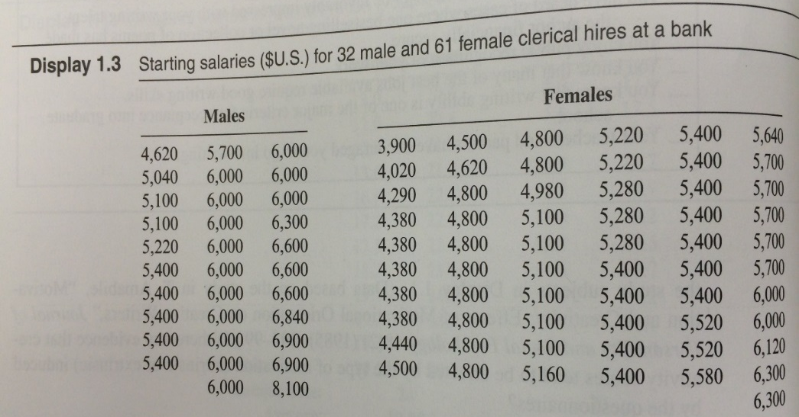

Causal Inference:
Randomized vs. Observational Study
Causal inferences can be drawn from randomized experiments
Causal inferences cannot be drawn from observational studies due to CONFOUNDING
What are some possible confounding variables in the gender/salary study?
In the starting salaries study, maybe males have
more education
more seniority
more age (older)
more willingness to negotiate starting salary
Younger
oyyoyyyoyoo
oooyyyoyoyy
oyyoyyyoyooy
oooyyyoyoyy
Older
In a randomized experiment, variables like age are also randomly distributed to each group, removing the confounding effect.

Slide 8
Why do an observational study?
Establishing causation not always the goal
Randomization may not be ethical
May be arguable scientifically that a confounder is “unlikely”
Might have an incidentally observed dataset
Predict whether or not an email is spam
Assign subjects of a clinical trial of a cancer drug to treatment or placebo
6 month smoking ban in Helena, MT coinciding with 40% reduction in heart attacks
Walmart collects petabytes of data/day. Should this data be discarded because it is observational?
Notes:
From June 2002 to December 2002 a smoking ban in Helena was enacted. During this time heart attacks dropped by 40%, but returned to previous levels afterwards. Helena has 1 hospital, so no hospital effect. Vietnam war draft is another example of Natural experiment.

Slide 9
Inference to Populations:
Random Sample vs. Self-Selection
Inference to populations can be drawn from a RANDOM SAMPLE FROM THAT POPULATION.
Inference to populations cannot be drawn if units are self-selected. In this creativity example, inference can only be drawn to the subjects in the sample that was taken.
RANDOM SAMPLE: Experimental units selected via a “chance mechanism” from a well defined population
Example: call randomly selected phone numbers for a survey.
What is the population from which the sample is taken? If drawing from a physical phone book, is it the people who live in the city?
Would this sampling method result in inferences to different populations if it were used in 1950? 1990? Present day?
SIMPLE RANDOM SAMPLE: Every subset of size n is equally likely
Example: I’ll assign everyone in this class a random integer 17, 200, -3, 472, … and survey the n people (units) with smallest numbers
Notes:
Ask: To what population is the SRS referencing?
Ask: After talking about simple random sample, talk about why the phone number example isn’t a simple random sample for the population of all people in a city.

Slide 10


Inference to Populations:
Random Sample vs. Self-Selection
Inference to populations can be drawn from a RANDOM SAMPLE
Inference to populations cannot be drawn if units are self-selected
WHICH OF THE STUDIES USES RANDOM SAMPLING?
Neither study uses random sampling
  Creativity study: units are volunteers
  Bank study: units are the entire staff
No inference about a larger population is possible
Does not mean the results are not interesting or compelling!
Notes:
Ask: To what population is the SRS referencing?
Ask: After talking about simple random sample, talk about why the phone number example isn’t a simple random sample for the population of all people in a city.

Slide 11
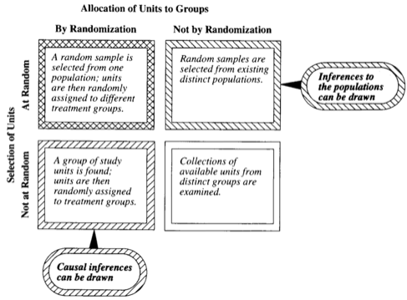
Statistical Inferences Permitted by Study Design
Notes:
Display 1.5

Slide 12

Practice with Scope: Q1
x
A particular study focused on high school freshman and seniors and their GPAs in a required economics class. The study consisted of enumerating every freshman and senior in the school and randomly selecting them from that sampling frame. Their scores in the economics class were then recorded, and a hypothesis test for the difference of means was conducted. The seniors were found to have a significantly greater mean score in the class than the freshman. What sort of conclusions can be made from this study? In other words, what is the scope of this study? In this class, scope typically constitutes both the causal inferences and populations inferences.
Since the subjects cannot be randomly assigned to be freshman or seniors, this is an observational study, and thus the difference in mean scores is only associated with the freshman / senior status. We can’t tell if the class (freshman or senior) caused the difference or not.
The sample was a random sample from the school; therefore, these findings can be generalized to all freshman and seniors in the school. In conclusion, it can be inferred that the mean economics score of the seniors in the school is greater than that of the freshman although the cause of this difference cannot be determined from this study.

Slide 13
Practice with Scope: Q2
x
The Navy is very interested in the effects of sleep deprivation on cognitive ability. In order to test the effect, the Navy put out a radio advertisement asking for 18 to 35 year old nonsmokers to participate in the study. The volunteers were then placed in either the control group (no sleep deprivation) or the treatment group (36 hours of sleep deprivation) based on the flip of a fair coin (Heads = Control, Tails = Treatment). After the data was collected, the sleep deprived group was found to have a significantly lower mean math score than the group not deprived of sleep. What sort of conclusions can be made from this study? In other words, what is the scope of this study (causal inferences and population inferences)?
Since the subjects were randomly assigned to the control and treatment groups, this is a randomized experiment; thus, the difference in mean scores can be concluded to be caused by the sleep deprivation. Since the subjects were volunteers who responded to a radio advertisement, it is easy to see that every member of the population did not have the same chance of being selected, and thus the sample is NOT a random sample. Therefore these findings cannot be generalized to all U.S. nonsmokers between the age of 18 and 35. In conclusion, it can be inferred that sleep deprivation caused the decrease in cognitive ability (as measured by the timed math test) for these 57 individuals only.

Slide 14
Drawing Statistical Conclusions
MEASURING UNCERTAINTY IN RANDOMIZED AND OBSERVATIONAL STUDIES

Slide 15


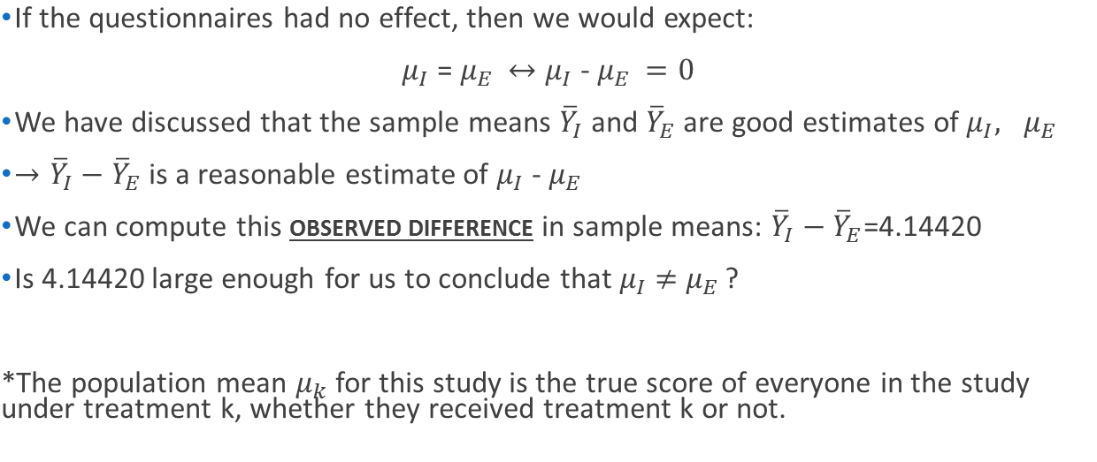
Creativity Study
I
I
E
(NULL HYPOTHESIS)
(TEST STATISTIC)
(ALTERNATE HYPOTHESIS)

Slide 16
Creativity Study
4 out of 6 groupings have test statistics as extreme or more extreme than the original grouping.
As extreme or more extreme means the absolute value of the test statistic is at least 4.5.
So the p-value is 4/6 = 0.667. This answers the question of how unusual our test statistic would be if the treatments had the same effect.
For the sake of the example, supposed there are only 4 subjects.
Int (Grp 1) | Ext (Grp 2)
12 Bob | 5 Dan
17 Sue | 15 Sal
Avg. 14.5 | Avg. 10
Diff 14.5 – 10 = 4.5
To quantify “large,” we can randomly reallocate units to two groups and recompute the difference in sample means many times.
*Everyone has the same score with each grouping. The group each person is artificially put in changes with each regrouping. If the treatments had the same effect, then each participant would have the same score regardless of grouping.
(Grp 1) | (Grp 2)
12 Bob | 5 Dan
15 Sal | 17 Sue
Avg. 13.5 | Avg. 11
Diff 13.5 – 11 = 2.5
(Grp 1) | (Grp 2)
15 Sal | 5 Dan
17 Sue | 12 Bob
Avg. 16 | Avg. 8.5
Diff 16 – 8.5 = 7.5
All other possible groupings:
(Grp 1) | (Grp 2)
12 Bob | 17 Sue
5 Dan | 15 Sal
Avg. 8.5 | Avg. 16
Diff 8.5 – 16 = -7.5
(Grp 1) | (Grp 2)
5 Dan | 12 Bob
17 Sue | 15 Sal
Avg. 11 | Avg. 13.5
Diff 11 – 13.5 = -2.5
(Grp 1) | (Grp 2)
5 Dan | 12 Bob
15 Sal | 17 Sue
Avg. 10 | Avg. 14.5
Diff 10 – 14.5 = -4.5

Slide 17

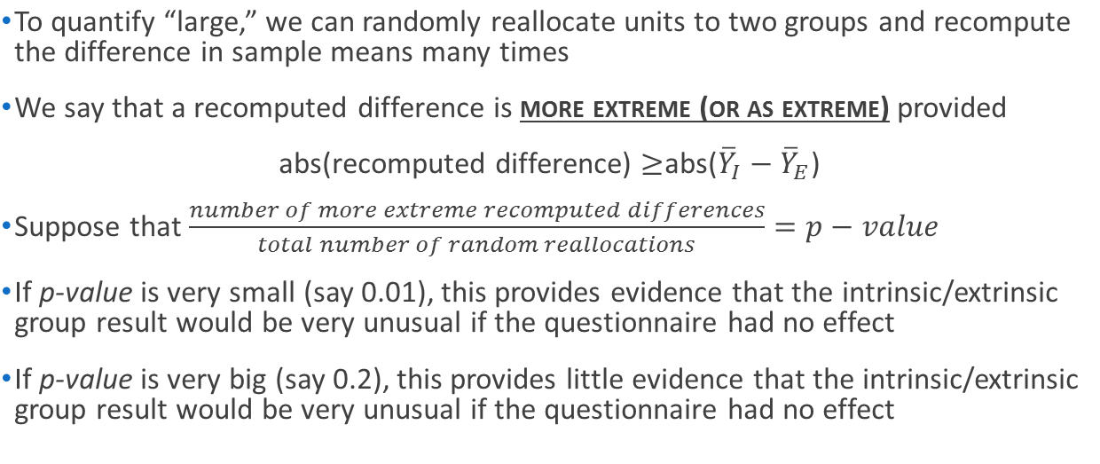
Creativity Study: all 47 subjects
I
E
(P-VALUE)

Slide 18
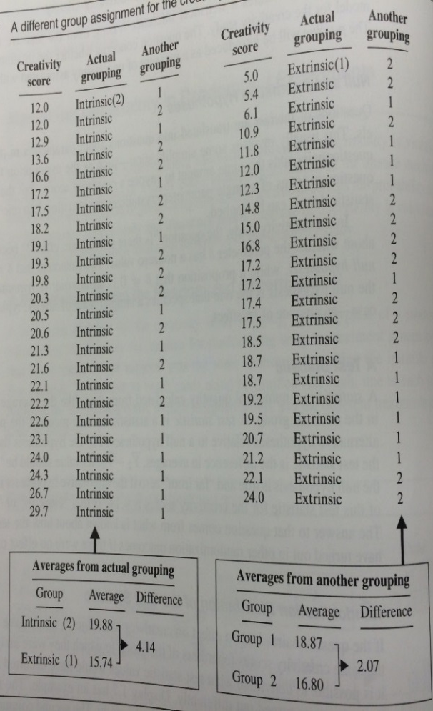
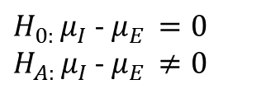
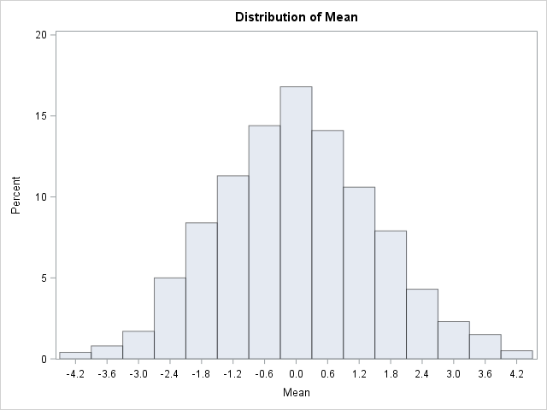

Creativity Study:
Testing the Hypothesis
Number of random regroupings:
1.6 x 10¹³
1000 different groupings (relabelings)*
Half a year with a computer that can perform a million calculations per second!
-4.14
4.14
*Everyone has the same score with each grouping. What group each person is artificially put in changes with each regrouping. If the treatments had the same effect, then each participant would have the same score regardless of grouping.

Slide 19
Creativity Study
(go to SAS code)
The TTEST Procedure
Variable: score
treatment | Method | Mean | 95% CL Mean |  | Std Dev | 95% CL Std Dev
0 |  | 19.8833 | 18.0087 | 21.7580 | 4.4395 | 3.4504 | 6.2276
1 |  | 15.7391 | 13.4677 | 18.0105 | 5.2526 | 4.0623 | 7.4343
Diff (1-2) | Pooled | 4.1442 | 1.2914 | 6.9970 | 4.8541 | 4.0261 | 6.1138
Diff (1-2) | Satterthwaite | 4.1442 | 1.2776 | 7.0108

Slide 20
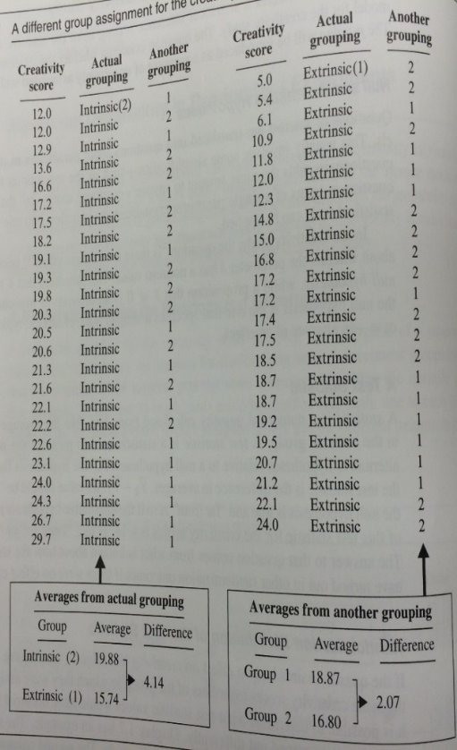
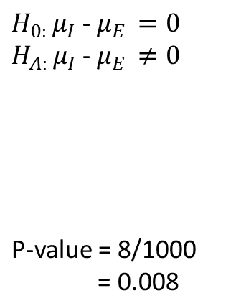

Creativity Study
-4.14
4.14
1000 different groupings (relabelings)
Obs | Variable | Class | Method | Variances | Mean | LowerCLMean | UpperCLMean | StdDev | LowerCLStdDev | UpperCLStdDev | UMPULowerCLStdDev | UMPUUpperCLStdDev
1 | COL139 | Diff (1-2) | Pooled | Equal | 4.4678 | 1.6594 | 7.2762 | 4.7786 | 3.9635 | 6.0187 | 3.9360 | 5.9708
2 | COL170 | Diff (1-2) | Pooled | Equal | -4.3192 | -7.1485 | -1.4899 | 4.8141 | 3.9930 | 6.0634 | 3.9653 | 6.0152
3 | COL279 | Diff (1-2) | Pooled | Equal | -4.5576 | -7.3530 | -1.7623 | 4.7564 | 3.9451 | 5.9908 | 3.9178 | 5.9430
4 | COL360 | Diff (1-2) | Pooled | Equal | -4.8897 | -7.6340 | -2.1454 | 4.6695 | 3.8731 | 5.8814 | 3.8462 | 5.8345
5 | COL537 | Diff (1-2) | Pooled | Equal | 4.3826 | 1.5621 | 7.2031 | 4.7991 | 3.9806 | 6.0446 | 3.9530 | 5.9964
6 | COL551 | Diff (1-2) | Pooled | Equal | -5.0514 | -7.7692 | -2.3337 | 4.6243 | 3.8356 | 5.8245 | 3.8090 | 5.7781
7 | COL604 | Diff (1-2) | Pooled | Equal | -4.7109 | -7.4832 | -1.9385 | 4.7172 | 3.9127 | 5.9415 | 3.8855 | 5.8942
8 | COL664 | Diff (1-2) | Pooled | Equal | 4.6636 | 1.8840 | 7.4431 | 4.7295 | 3.9228 | 5.9569 | 3.8956 | 5.9095
There is strong evidence to suggest that the mean score of those who receive intrinsic motivation is not equal to those who receive the extrinsic motivation (p-value = .008). The burden to reject the null hypothesis is lower under a one-sided test, so we can say that the evidence supports the claim that the intrinsic mean is higher than the extrinsic mean.
Since this was a randomized experiment, we can conclude that the intrinsic motivation caused this increase. In addition, since these were volunteers, this inference can only be assumed to apply to these 47 subjects, although the findings are very intriguing.

Slide 21
From Randomized to Observational Studies
In the Creativity study, the Intrinsic/Extrinsic groups were randomly assigned to subjects
This motivated comparing the observed difference to re-randomized difference to test a hypothesis about the questionnaire having no effect
This is known as a RANDOMIZATION TEST
In observational studies, the groups are not randomly assigned
Though not technically the same test, we can still apply exactly the same re-randomization idea to observational data
However, now it is called a PERMUTATION TEST

Slide 22
Appendix

Slide 23
Age Discrimination
In the United States, it is illegal to discriminate against people based on various attributes. One such attribute is age. An active lawsuit, filed August 30, 2011, in the Los Angeles District Office is a case against the American Samoa Government for systematic age discrimination by preferentially firing older workers.
Is there evidence for age discrimination in this study?
Data sampled at random from all American Samoa government workers:
Fired
34 37 37 38 41 42 43 44 44 45 45 45 46 48 49 53 53 54 54 55 56
Not fired
27 33 36 37 38 38 39 42 42 43 43 44 44 44 45 45 45 45 46 46 47 47 48 48 49 49 51 51 52 54

Slide 24
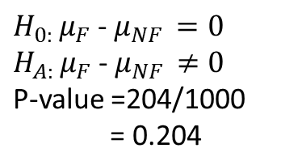

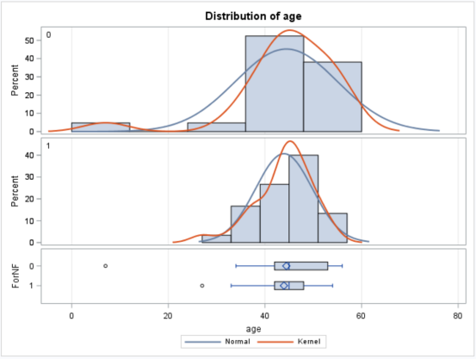
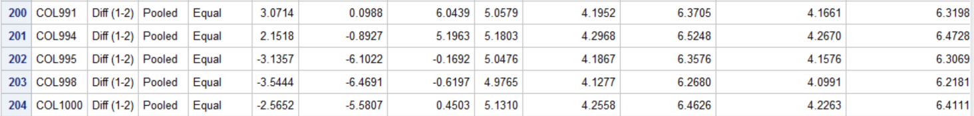
Age Discrimination (Two Sided)
Fired
34 37 37 38 41 42 43 44 44 45 45
45 46 48 49 53 53 54 54 55 56
Not fired
27 33 36 37 38 38 39 42 42 43 43 44
44 44 45 45 45 45 46 46 47 47 48 48
49 49 51 51 52 54
-1.9238
1.9238
1000 different groupings (relabelings)
There is not sufficient evidence to suggest that the mean age of those who were fired is different from the mean age of those who were not fired (p-value = 0.204). The p-value is so high that even the null hypothesis of a one-sided test cannot be rejected. (There is insufficient evident to claim that the mean age of fired employees is greater than that of not fired employees.)
Since this was a random sample of government employees in Samoa, we can generalize this inference to all government-employed people in Samoa.
Note: since we FTR (fail to reject) Ho, there is no need to discuss causation or association.

